Slide 1
SIC Capstone Project
Hate Speech Detection

Slide 2
Supervisor
Dr. M. Shahid Iqbal Malik

Slide 3
Group Members
Mr. Muhammad Haseeb Ahmad
Mr. Mubin Malick
Mr. Hammad Hussain
Mr. Mohammad Abdul Rafay
Mr. Zaid Bin Zaheer
Mr. Hammad Waseem

Slide 4
Proposed methodology
Datasets
Sr. | Datasets | Title | Labels & Counts | #Posts
1 | D1 [1] | Hate & Offensive | Hate: 1430 Offensive: 19,190 Neutral: 4163 | 24,783
2 | D2 [2] | Racist/Sexist | Racist/Sexist:2243 Non-Racist/Sexist:29720 | 31,963
3 | D3 [3] | Offensive | Offensive: 4400 Non-Offensive: 8840 | 13,240

Slide 5
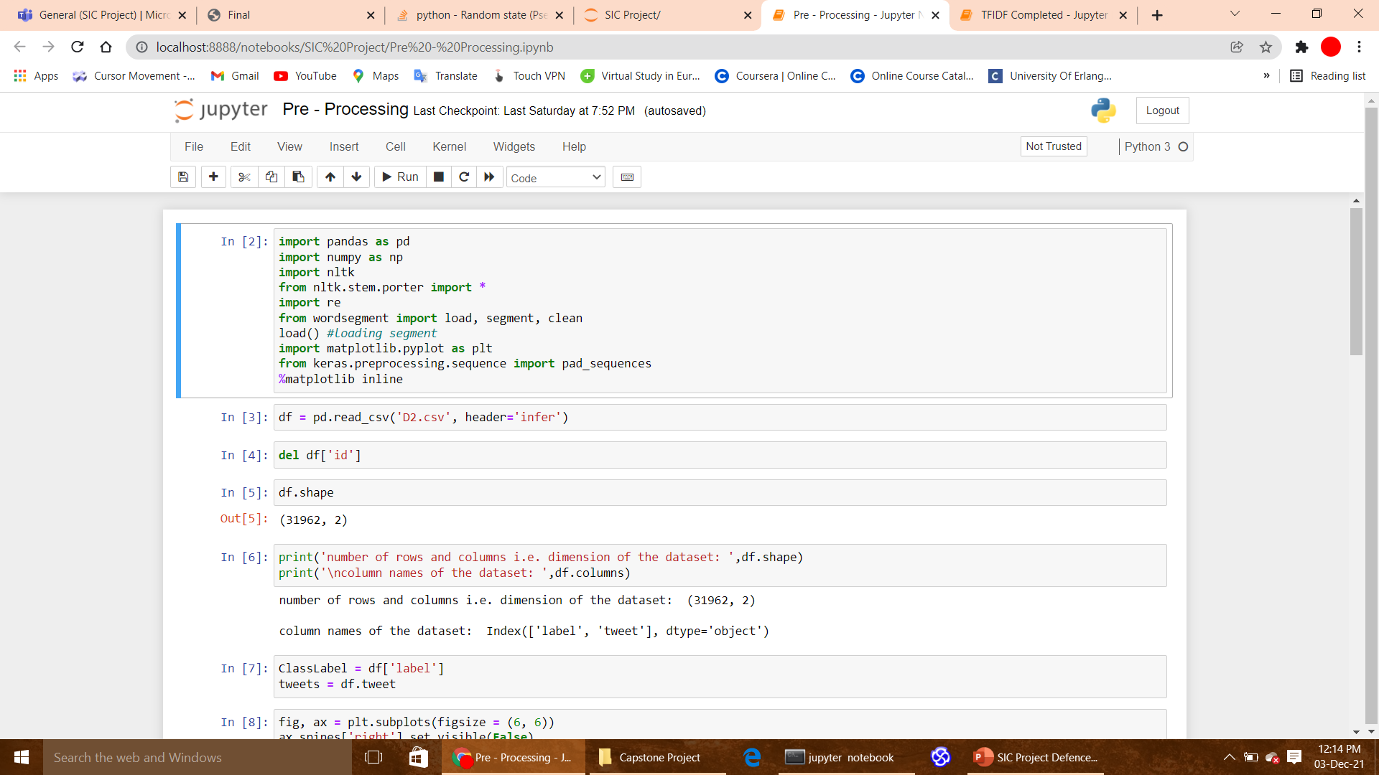
Preprocessing

Slide 6
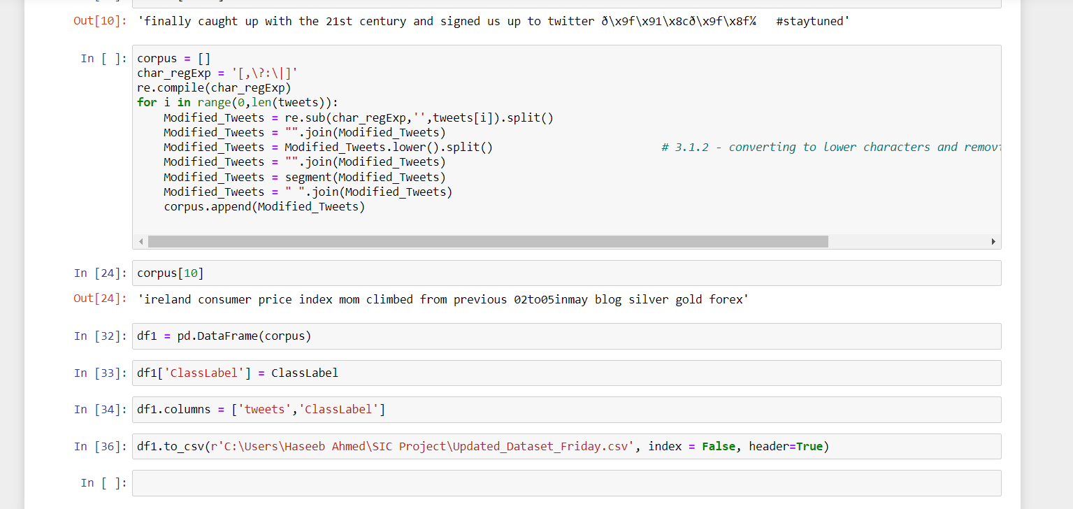

Slide 7
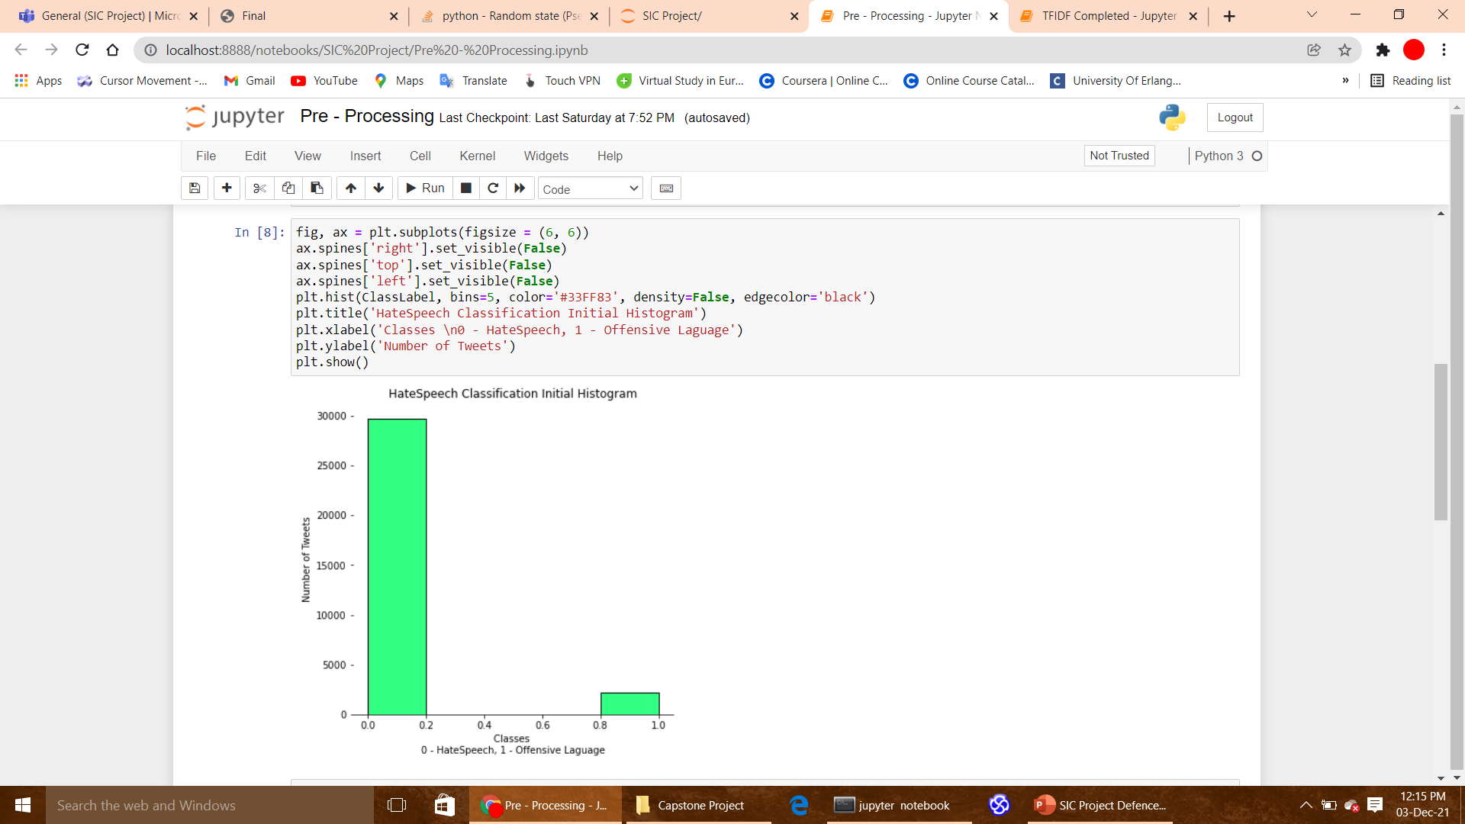
Visualization

Slide 8
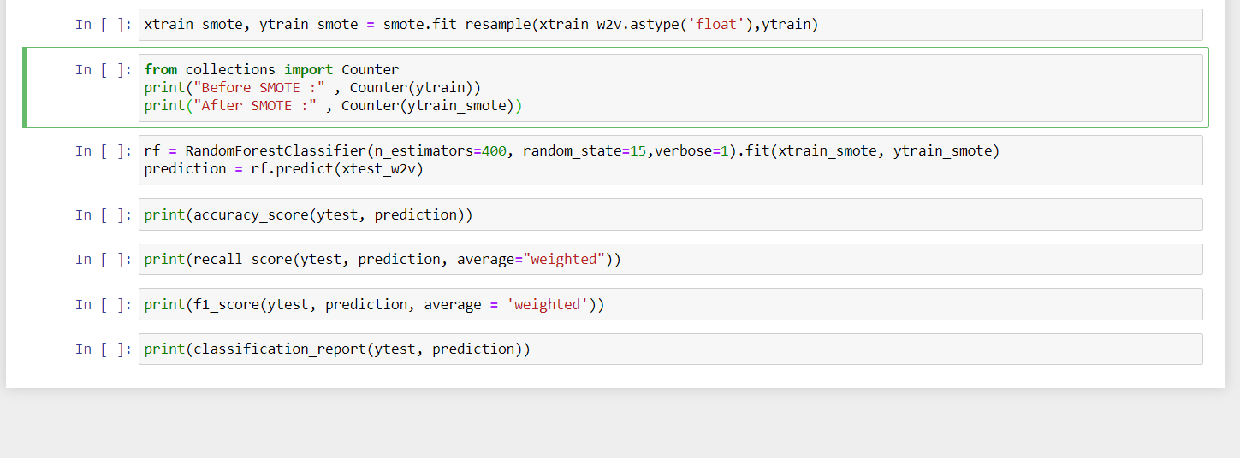

Slide 9
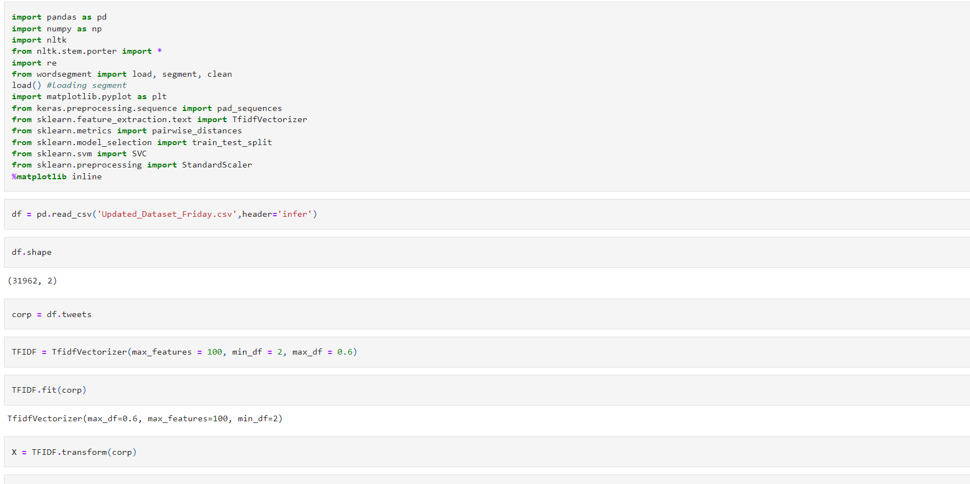
TFIDF

Slide 10
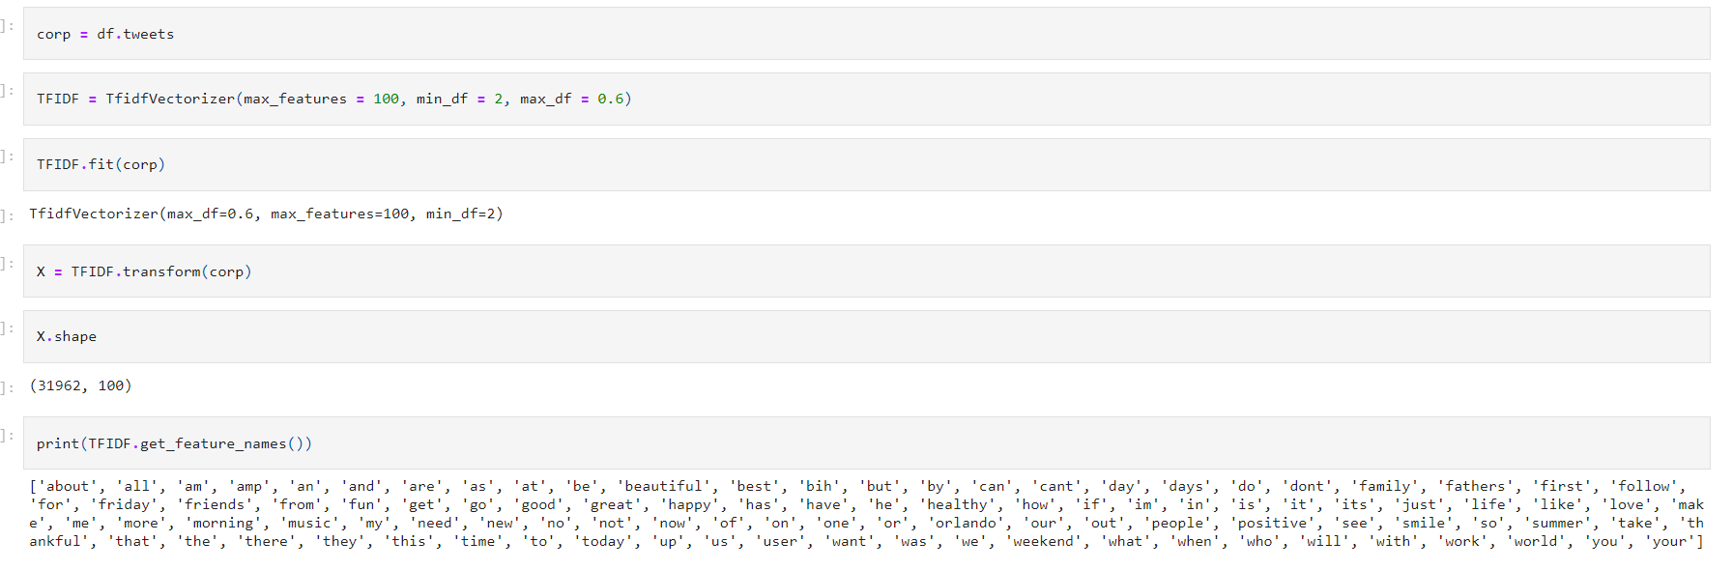

Slide 11
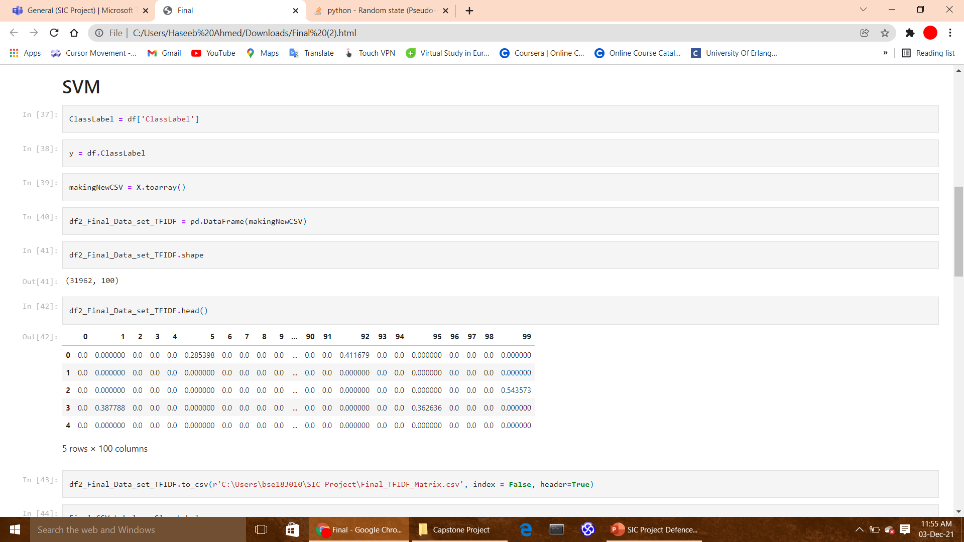
SVM

Slide 12
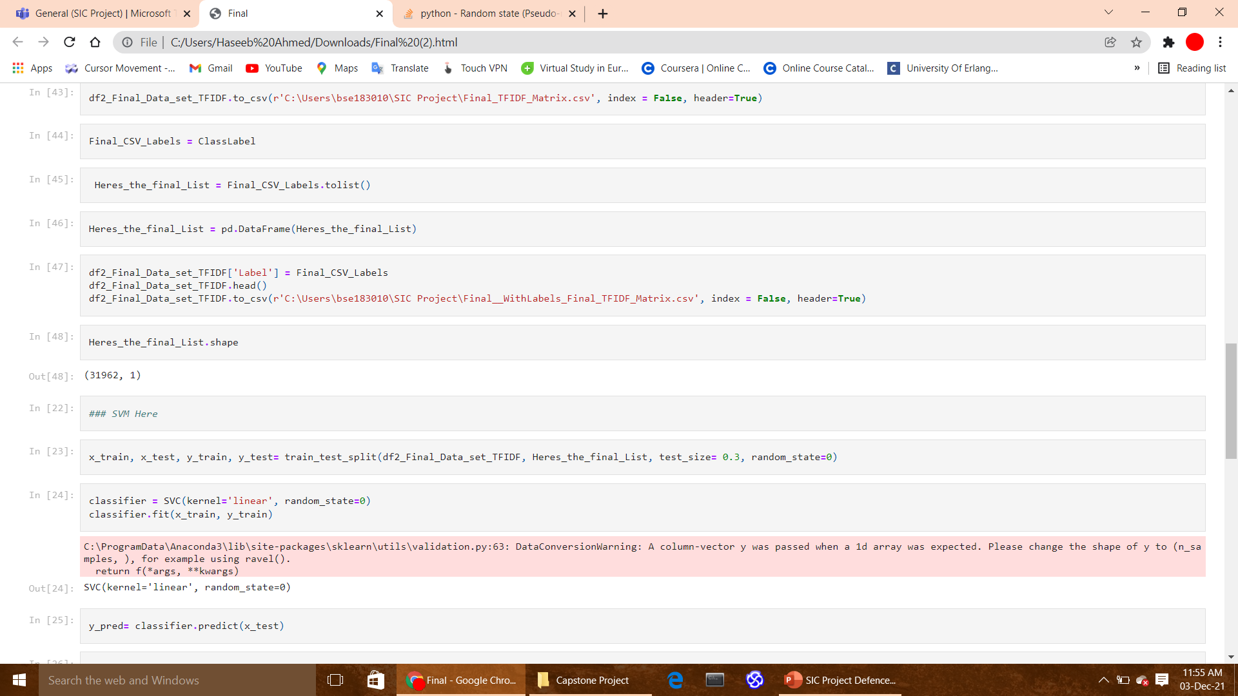

Slide 13
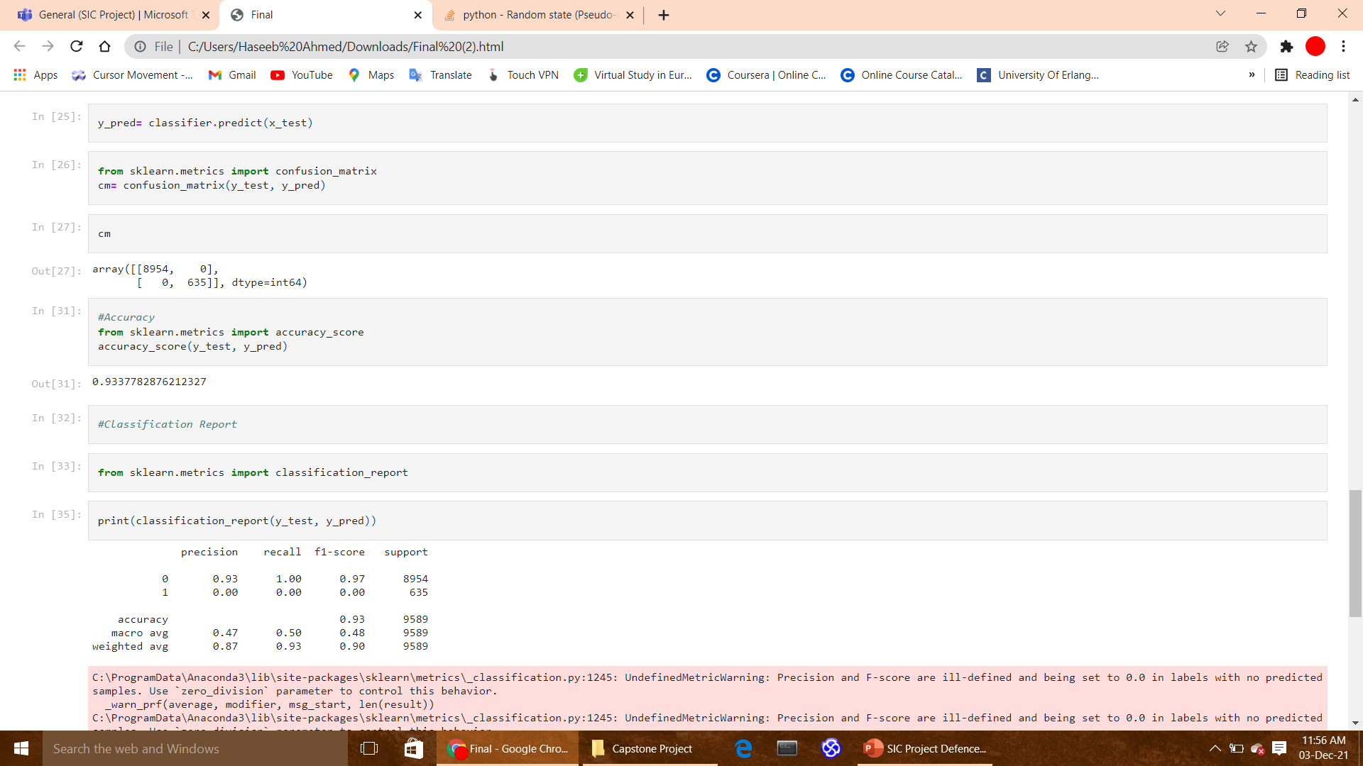

Slide 14
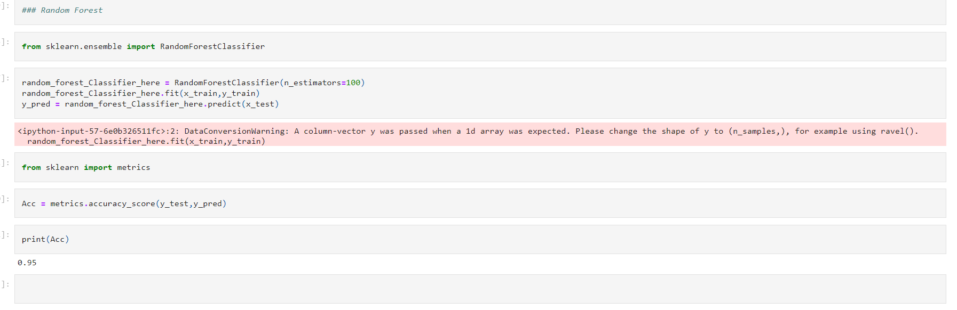
Random Forest

Slide 15
Word2Vec/SVM (Dataset 1)

Slide 16
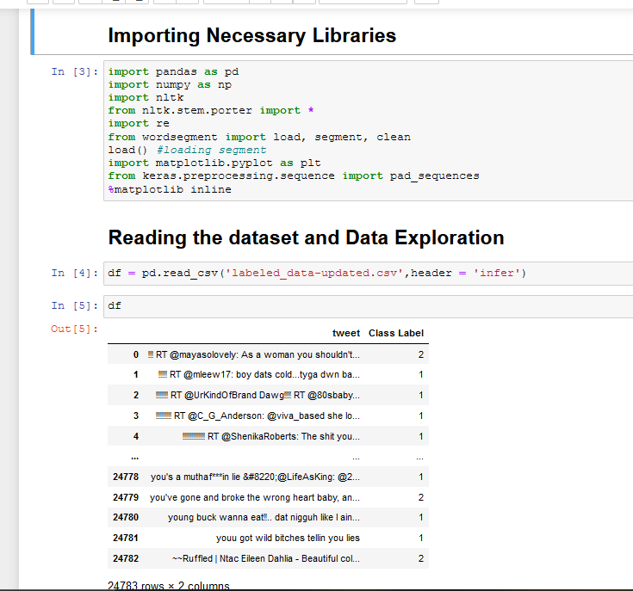
Preprocessing

Slide 17
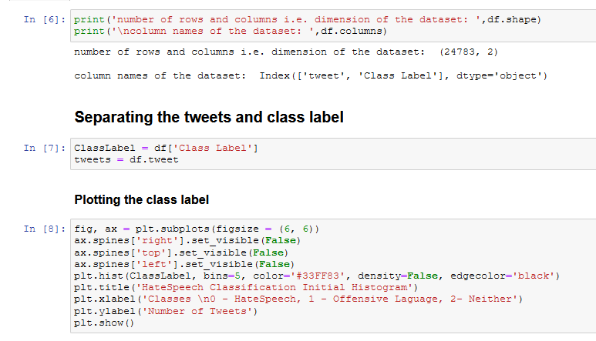
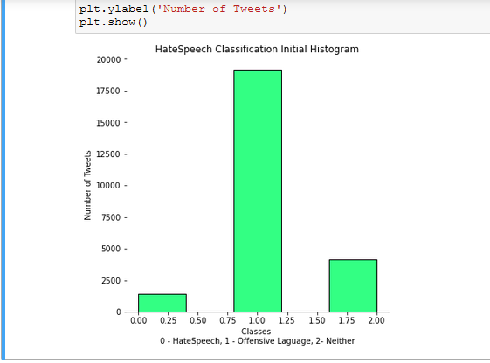
Continue…..

Slide 18
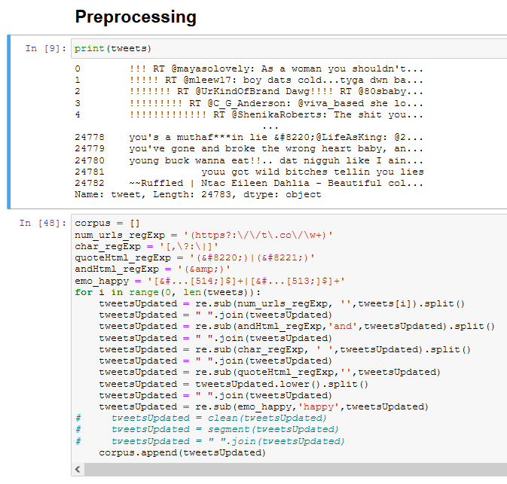
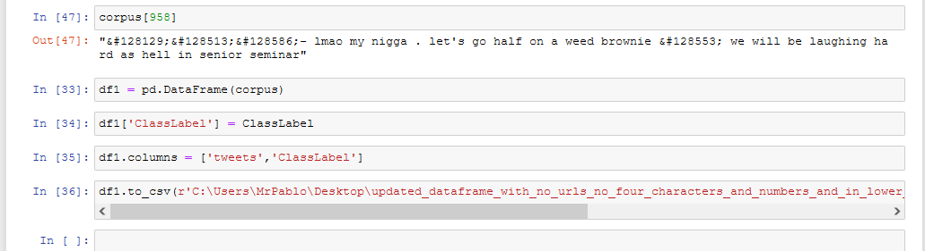
Continue…

Slide 19
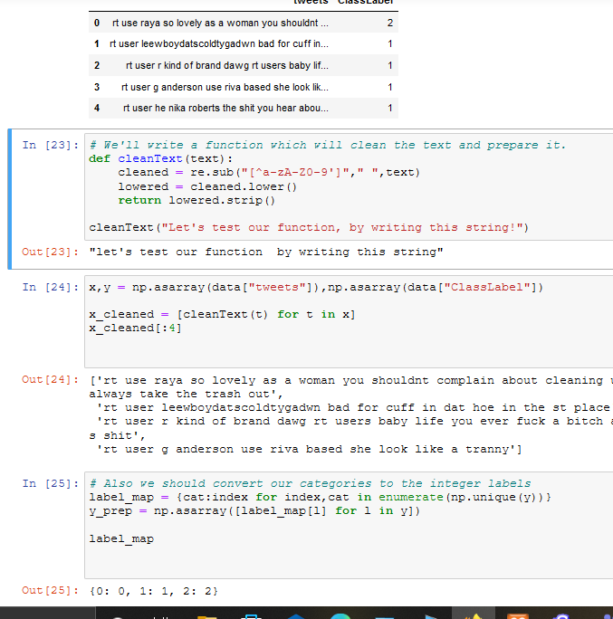
Continue….

Slide 20
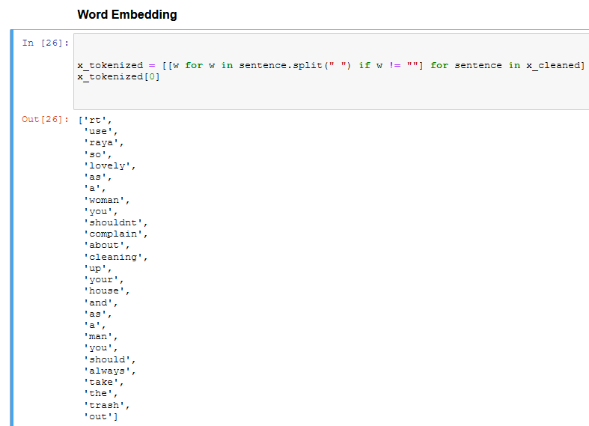
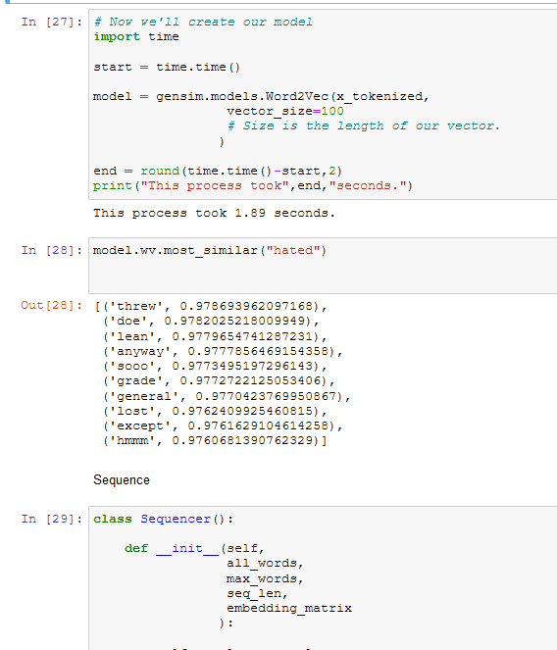
Word Embedding

Slide 21
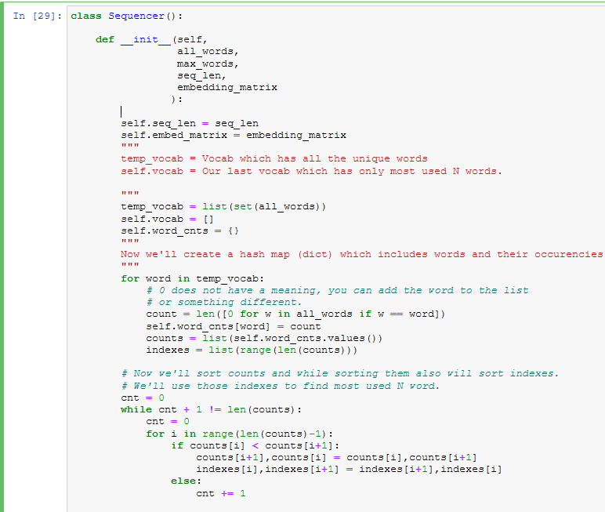
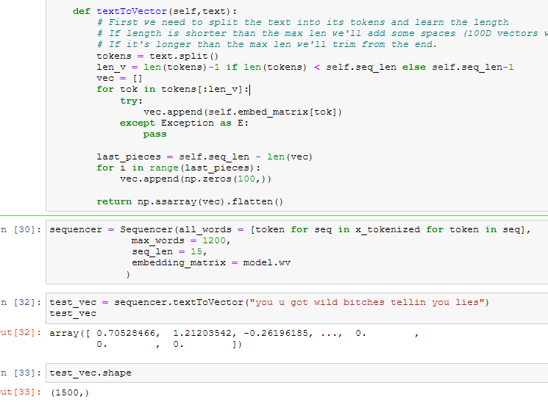
Continue…

Slide 22
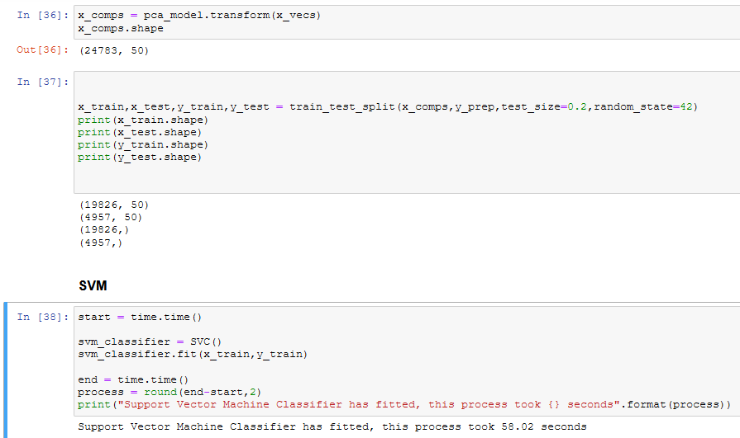
SVM

Slide 23
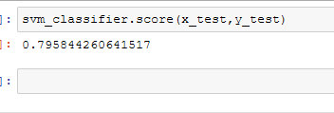
Accuracy

Slide 24
Proposed methodology cont.…
Block diagram
Gather data
Preprocessing
Training the classifier
Evaluating classifier to learn from feature-category mapping
Using the classifier to classify tweets data
Hate
Feature extraction
Not Hate
Training of the classifier
Testing the classifier

Slide 25
Proposed methodology cont.…
Preprocessing
Characters like | : , ? are removed along with the URLs and numbers.
The words are reduced into the lower case so that words such as “Hate”, “hate” and “HATE” will have the same syntax and will utilize the same pre-trained embedding values.
Word segmentation is being done using the Python based word segment⁴ to preserve the important features present in the hashtag mentions. Some of the examples are #killerblondes => killer blondes etc.
All the @ (ex.@Mubinmalick) mentions will be replaced with the common token i.e. USER.
4 http://www.grantjenks.com/docs/wordsegment/.

Slide 26
Proposed methodology cont.…
Feature extraction
Sr. | Embedding | Dataset
1 | Word2vec & TFIDF | D2
2 | Word2vec & FastText | D3
3 | Word2vec & BERT | D1

Slide 27
Proposed methodology cont.…
Machine learning classification models
Support vector machine
“Support Vector Machine” (SVM) is a supervised machine learning algorithm that can be used for both classification or regression challenges. However, it is mostly used in classification problems. In the SVM algorithm, we plot each data item as a point in n-dimensional space (where n is a number of features you have) with the value of each feature being the value of a particular coordinate. Then, we perform classification by finding the hyper-plane that differentiates the two classes very well.[4]
Random forest classifier
The random forest is a model made up of many decision trees. Rather than just simply averaging the prediction of trees (which we could call a “forest”),[5] this model uses two key concepts that gives it the name random:
Random sampling of training data points when building trees
Random subsets of features considered when splitting nodes.

Slide 28
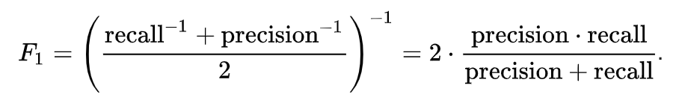
Proposed methodology cont.…
Evaluation metrics
Accuracy
The proportion of the total number of classification that were correct.
Recall
The proportion of actual positive cases which are correctly identified.
F1-score
F1-Score is the measure for test accuracy. The formula for F1-Score is as follows:

Slide 29




Application
Several Organization, social media platforms may use this model in their chat modules to avoid hate speech text.

Slide 30
References
[1]: Davidson Thomas, Dana Warmsley, Michael Macy, Ingmar Weber, Weber automated hate speech detection and the problem of offensive language, 2017, arXiv preprint arXiv:1703.04009.
[2]: https://www.kaggle.com/arkhoshghalb/twitter-sentiment-analysis-hatred-speech
[3]: Zampieri Marcos, Shervin Malmasi, Preslav Nakov, Sara Rosenthal, Noura Farra, Ritesh Kumar, Predicting the type and target of offensive posts in social media, 2019, arXiv preprint arXiv:1902.09666.
[4]: https://www.analyticsvidhya.com/blog/2017/09/understaing-support-vector-machine-example-code/, last accessed on November 23, 2021
[5]: https://towardsdatascience.com/an-implementation-and-explanation-of-the-random-forest-in-python-77bf308a9b76, last accessed on November 23, 2021

